Slide 1
Introduction to Cryptography

Slide 2
Cryptography
Can be characterized by 3 independent dimensions:
type of operations used for encryption and decryption
substitution –Each element in the plain text is mapped into another element
transposition – Each element in the plaintext are rearranged
number of keys used
Symmetric
Asymmetric
way in which plaintext is processed
block cipher
stream

Slide 3
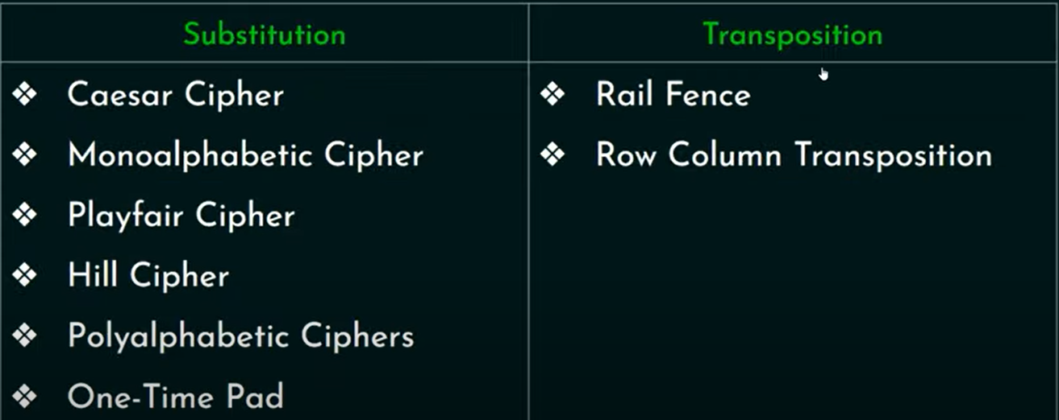

Slide 4
Substitution Techniques
A substitution technique is one in which the letters of plaintext are replaced by other letters or by numbers or symbols

Slide 5
1. Caesar Cipher
Simple
Replacing each letter of the alphabet with the letter standing three places further down the alphabet.
This mathematical description uses modulo arithmetic (ie clock arithmetic). Here, when you reach Z you go back to A and start again. Mod 26 implies that when you reach 26, you use 0 instead (ie the letter after Z, or 25 + 1 goes to A or 0).

Slide 6
Caesar Cipher
can define transformation as:
a b c d e f g h i j k l m n o p q r s t u v w x y z
D E F G H I J K L M N O P Q R S T U V W X Y Z A B C
mathematically give each letter a number
a b c d e f g h i j k l m
0 1 2 3 4 5 6 7 8 9 10 11 12
n o p q r s t u v w x y Z
13 14 15 16 17 18 19 20 21 22 23 24 25
then have Caesar cipher as:
C = E(p) = (p + k) mod (26)
p = D(C) = (C – k) mod (26)
Notes:
This mathematical description uses modulo arithmetic (ie clock arithmetic). Here, when you reach Z you go back to A and start again. Mod 26 implies that when you reach 26, you use 0 instead (ie the letter after Z, or 25 + 1 goes to A or 0).
Example: howdy (7,14,22,3,24) encrypted using key f (5) is MTBID

Slide 7
Plaintext: howdy (7,14,22,3,24)
key : 5
Encrypted Message: MTBID

Slide 8
Disadvantage
It can be easily hacked. It means the message encrypted by this method can be easily decrypted.
It provides very little security.
By looking at the pattern of letters in it, the entire message can be decrypted.

Slide 9
Play fair Cipher
https://www.geeksforgeeks.org/playfair-cipher-with-examples/

Slide 10
Hill Cipher

Slide 15
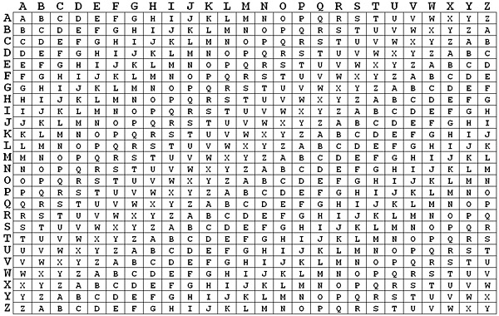
Vigenere Cpher

Slide 16
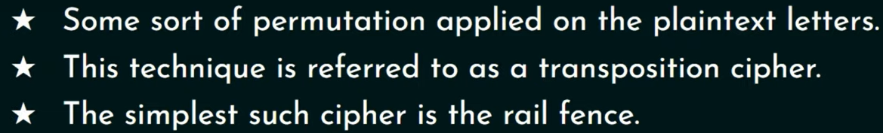
Transposition Cipher

Slide 17
Rail fence Technique
The plain text is written down as a sequence of diagonals and read off as a sequence of rows.

Slide 18
Row Column Transposition Cipher
It is more complex scheme compared to rail fence technique.
The rows and columns should be decided by the sender and the receiver.
The sender will write the plain text row by row.
Receiver will read the cipher text column by column.
Key is the order of the column

